Slide 1
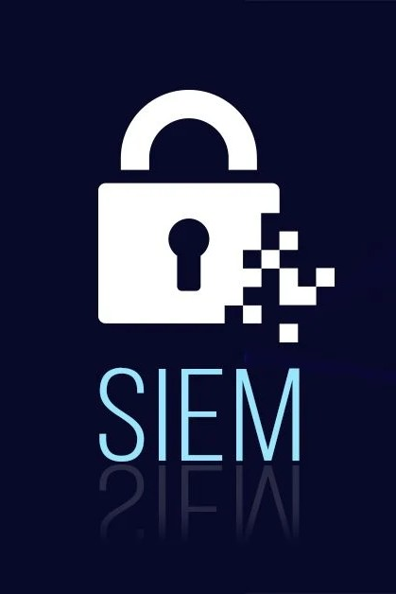
Elastic SIEM Integration with Kali Linux for Cybersecurity Monitoring
Presented By:
D.James Chrishan

Slide 2

Executive Summary
Overview: A project to set up a scalable and beginner-friendly cybersecurity lab.
Objective: Integrate Elastic SIEM with Kali Linux for threat monitoring and simulation.
Outcomes: Enhanced hands-on knowledge, improved threat detection capabilities, and accessible training resources.

Slide 3
Background and Rationale
Context: Growing demand for SIEM tools in detecting and responding to cyber threats.
Problem: Difficulty for beginners in accessing and setting up SIEM environments.
Significance: This project provides a simplified approach to understanding SIEM systems and their applications.

Slide 4
Objectives
Develop a functioning Elastic SIEM lab integrated with Kali Linux.
1
Perform live threat simulation using Nmap and analyze logs.
2
Provide accessible training materials for beginner-level users.
3
Achieve scalable and reusable results within a constrained environment.
4

Slide 5

Scope
Inclusions:
Elastic Agent setup.
Threat detection and alerting.
Functional documentation and training material.
Exclusions:
Enterprise-level configurations and paid integrations.
Deliverables: Functional lab environment, documentation, and user training resources.

Slide 6
Methodology
Approach: Iterative SDLC Model.
Tools: Elastic Stack, Kali Linux, Elastic Agent, Nmap.
Steps:
Analyze system requirements.
Configure Elastic Agent and Elastic Cloud.
Simulate threats using Kali Linux.
Test and refine configurations.

Slide 7
Literature Review
Technologies Reviewed:
Elastic SIEM.
Linux-based penetration testing.
Log management tools.
Trends: Increased adoption of cloud-based SIEM tools for real-time threat analysis.
Gaps: Limited beginner-friendly guides for SIEM setup and integration.

Slide 8
System Analysis and Design
Functional Requirements:
Real-time log collection.
Threat detection and alerting.
Non-functional Requirements:
High performance, usability, and scalability.
System Architecture: Centralized data collection with Elastic Agent on Kali Linux VM.

Slide 9
System Analysis and Design
Kali VM generates security events
Elastic Agent collects logs and forwards them
Elastic Cloud stores, processes, and analyzes logs
Dashboards and alerts in Kibana visualize results.

Slide 10

Coding and Implementation
Languages/Tools: Bash scripting, Elastic Agent, Elastic Cloud.
Key Configurations:
Elastic Agent installation on Kali Linux.
Data forwarding to Elastic Cloud.
Detection rule creation and testing.

Slide 11
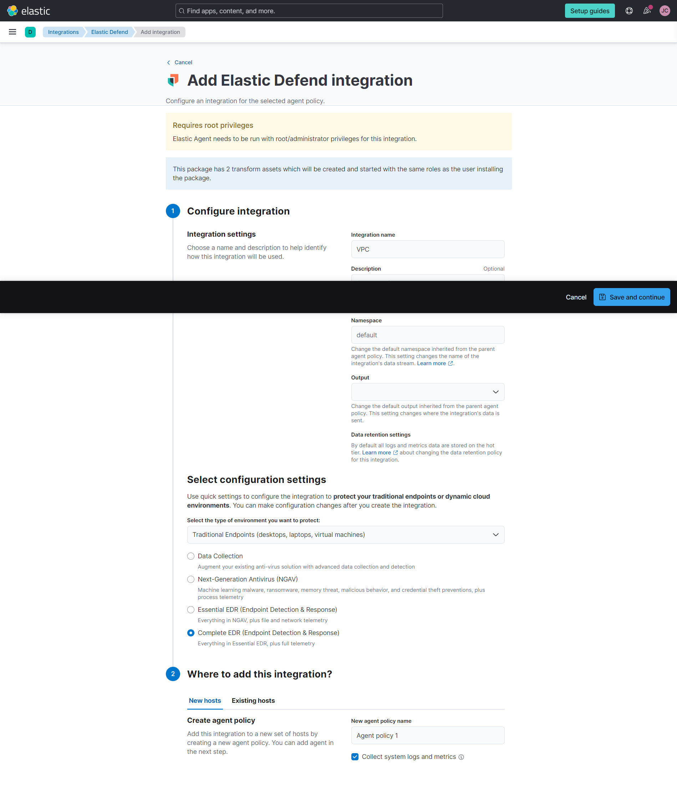
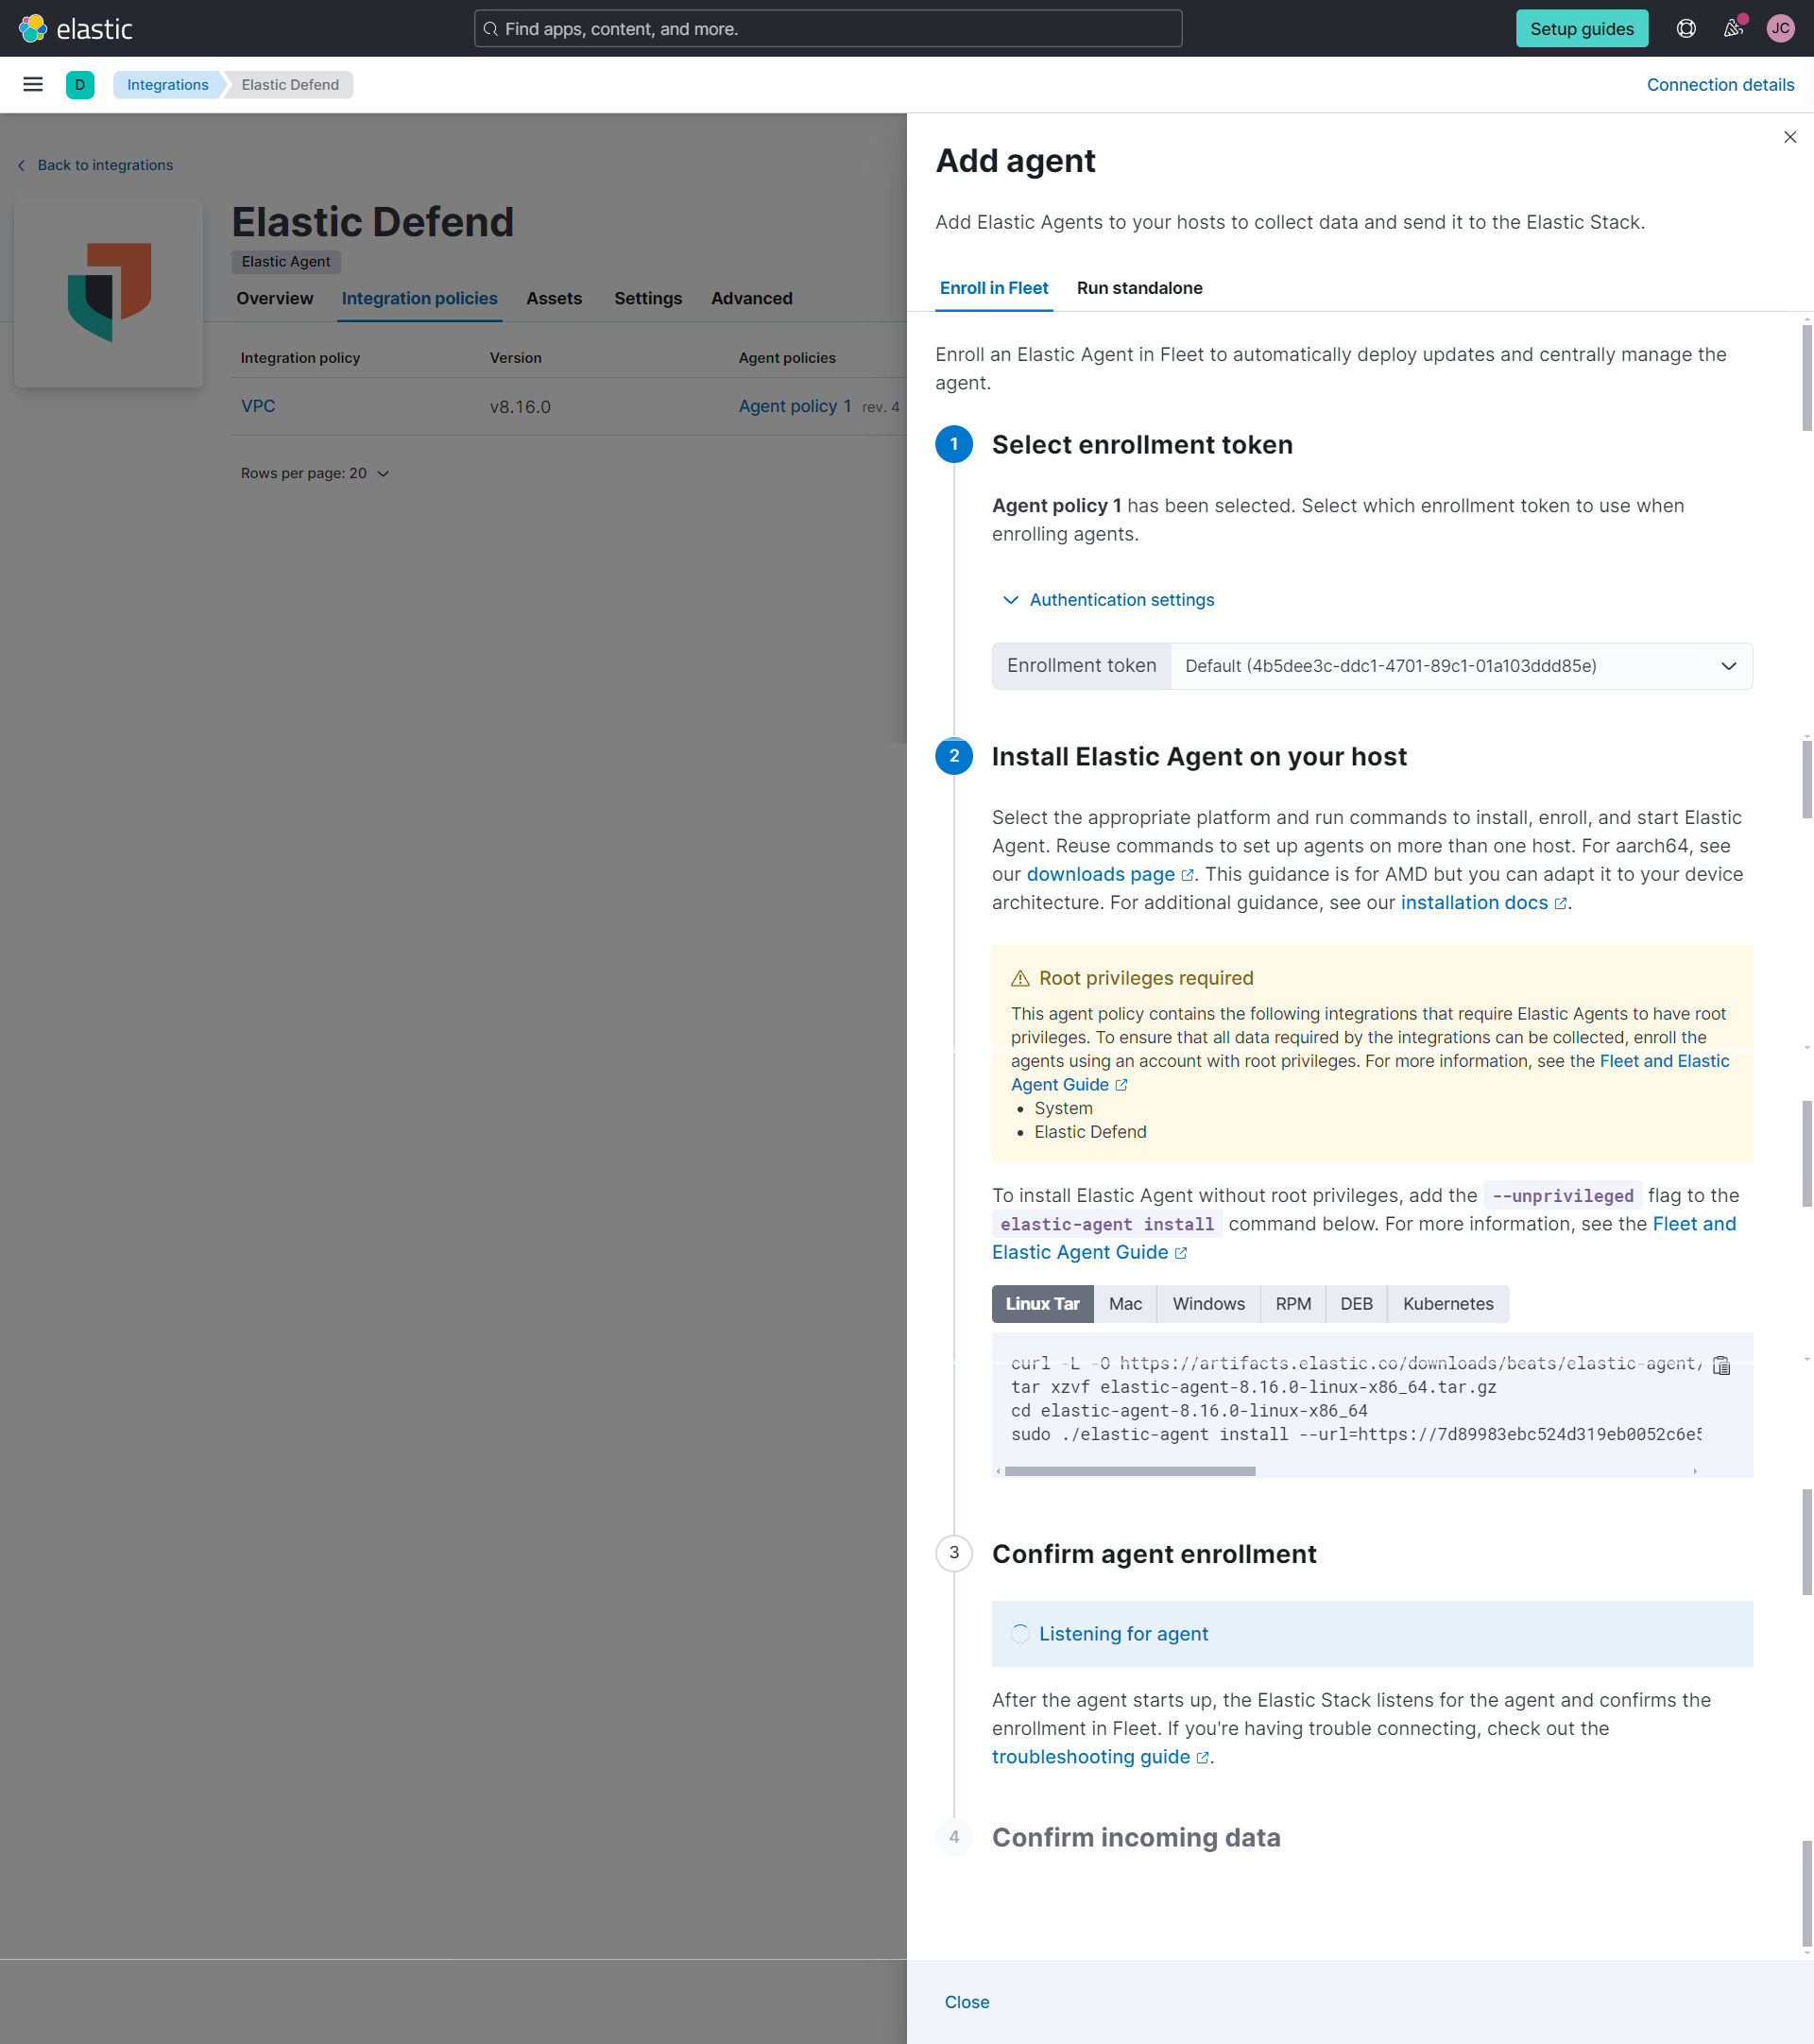
Elastic Defend instalation

Slide 12
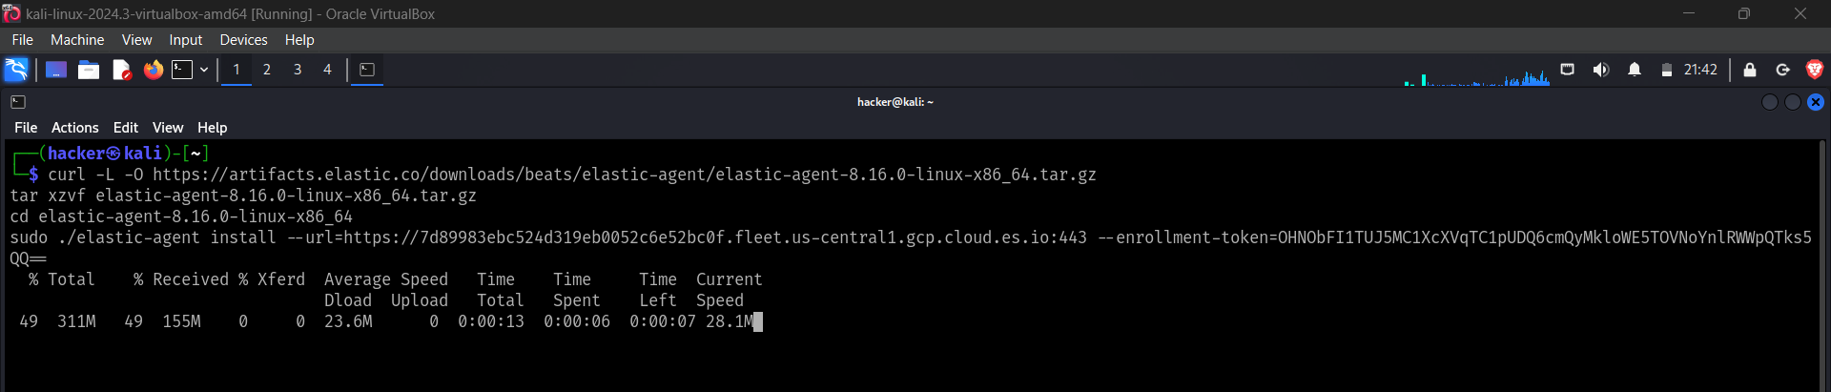
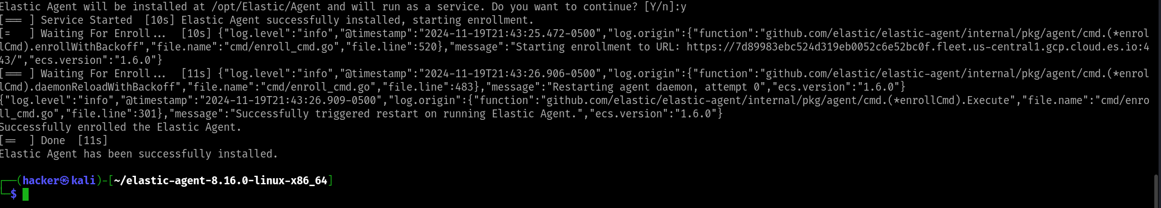
Elastic Agent installaton

Slide 13
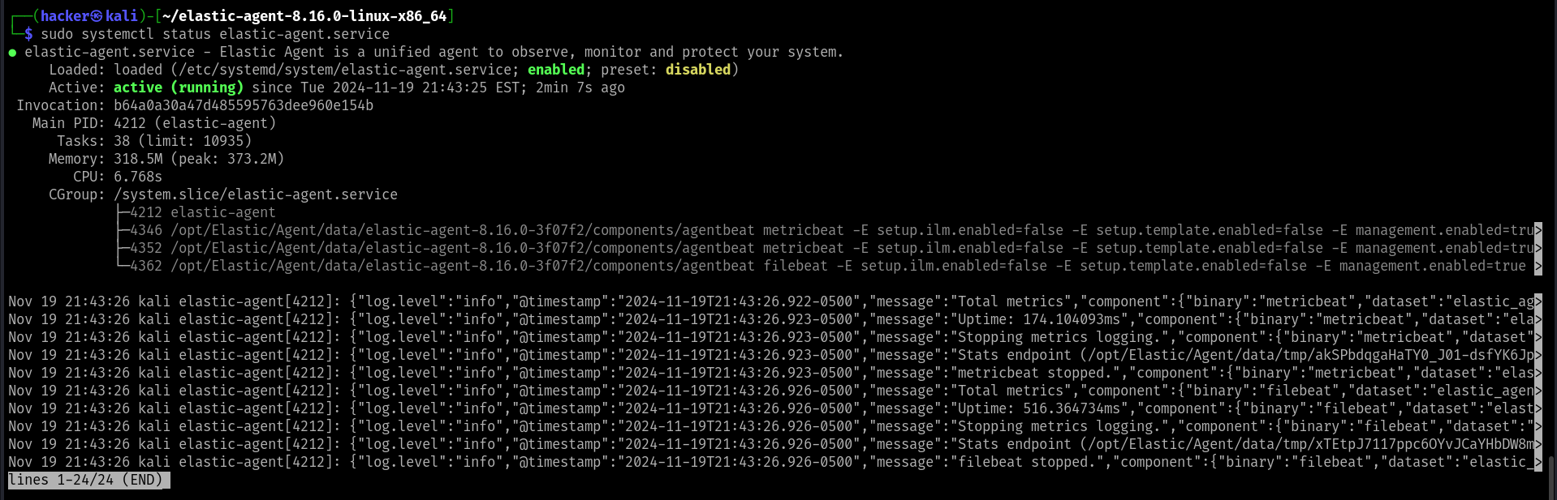
Confirmation of Elastic Defend

Slide 14
Testing Methodologies
Unit Testing:
Ensured proper log ingestion and encryption.
Evidence: Screenshots of unit test results.
System Testing:
Validated end-to-end functionality with simulated threats.

Slide 15
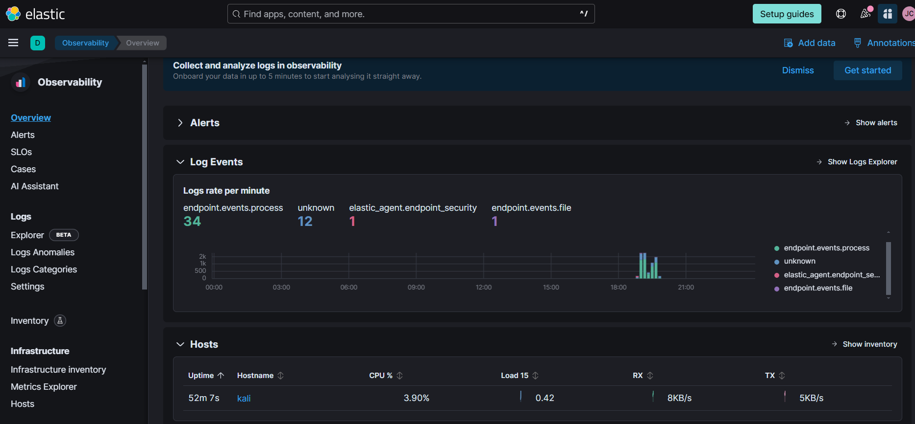
Unit testing

Slide 16
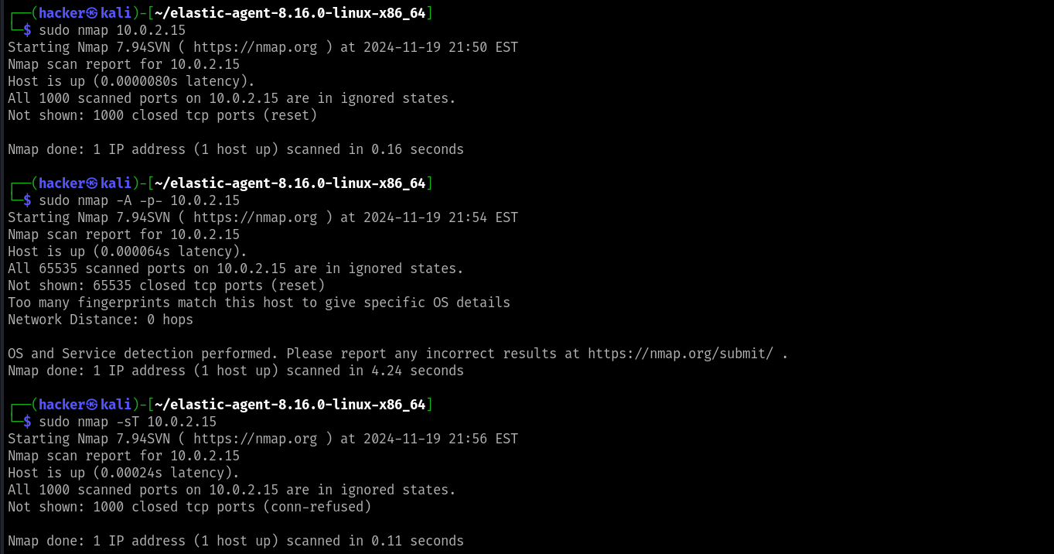
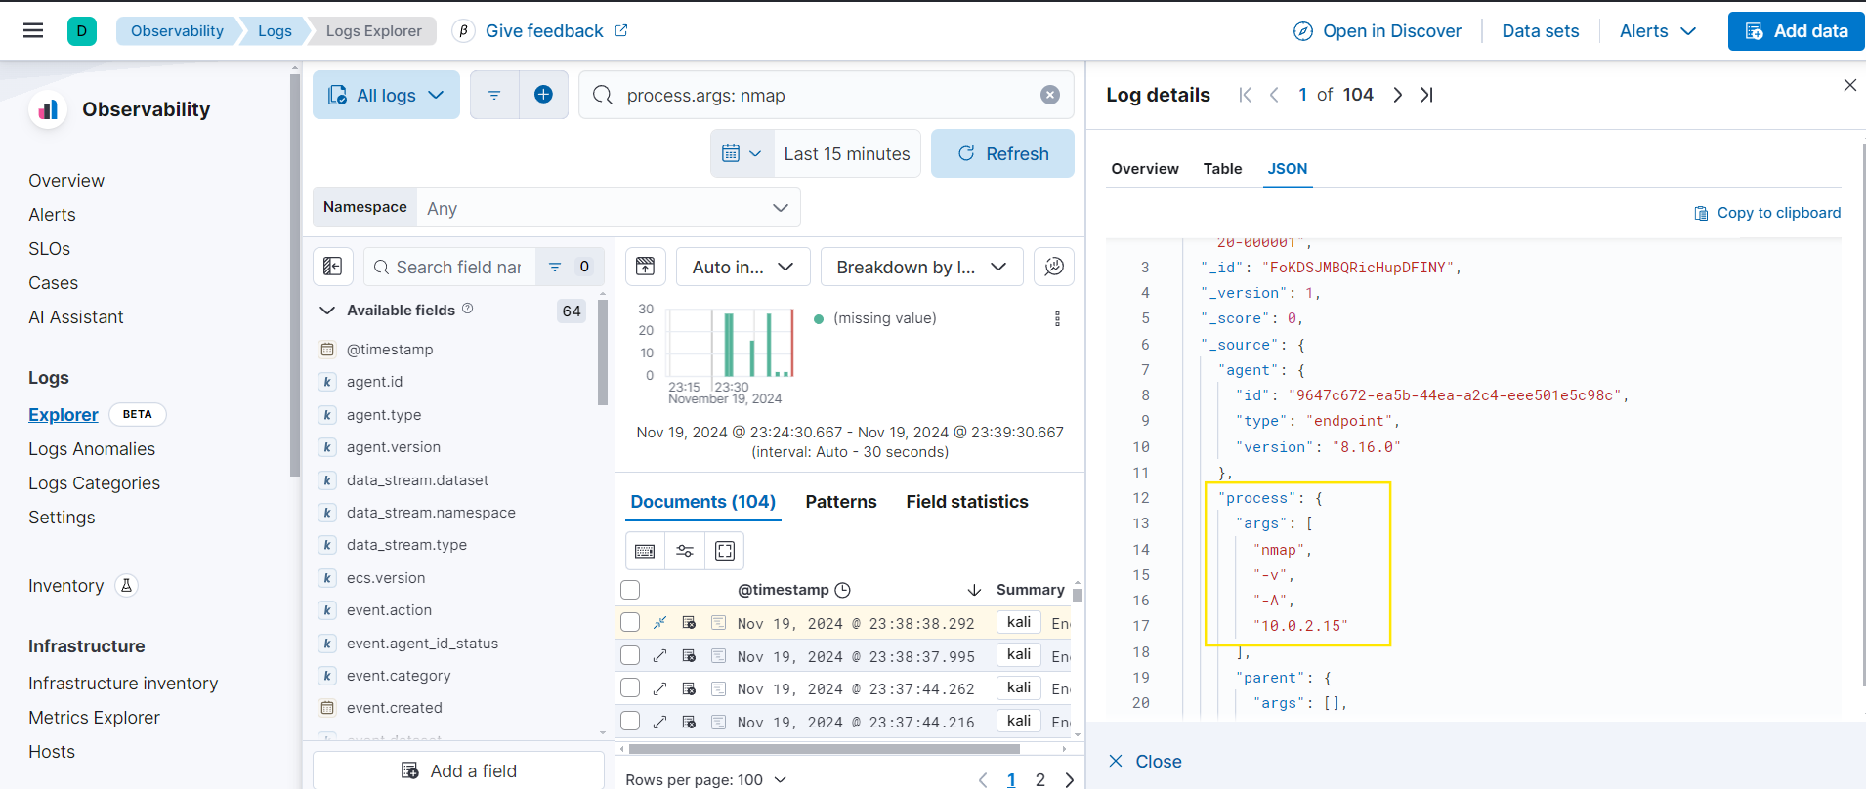
System testing

Slide 17
User Training and Support
Manuals Developed:
Installation and configuration guides.
Troubleshooting tips for common issues.
Training:
Webinars and hands-on workshops focusing on Elastic SIEM.
Key Content: Threat detection exercises, dashboard usage, and response simulations.
Support Channels:
Email, live chat, and a community forum.

Slide 18

Results and Discussion
Findings: Successfully detected and responded to simulated threats.
Implications: Strengthened hands-on skills for entry-level cybersecurity analysts.
Challenges Addressed: Resolved log parsing issues and misaligned detection thresholds.

Slide 19

Conclusion
Key Achievements:
Functional lab setup and tested threat simulations.
Comprehensive user training and support plans.
Challenges Overcome: Configuration mismatches and resource constraints.
Future Work: Expand on enterprise-level integrations and automated incident response.

Slide 20

Questions and Discussions
Thank you for your attention. We are happy to address your questions and receive feedback.

